Slide 1


INSTITUTE OF ENGINEERING AND TECHNOLOGY, LUCKNOW
Bachelor of Technology
in
Computer Science and Engineering
Presentation
on
Video-Based Face Recognition Attendance System
Submitted by:
Mayuri Shakya [2200520109104]
Sachin Kumar [2200520109106]
Amrendra Bahadur Yadav [2200520109101]
Supervised by:
Dr. Sakshi Srivastava
Er. Rakesh Kumar Gautam

Slide 2
Video-Based Face Recognition Attendance System
This Project automates student attendance by detecting and recognizing faces from live video streams using deep learning models.​

Slide 3

Face Recognition​
Face recognition technology uses algorithms to identify individuals based on unique fiducial points. This process involves capturing and analyzing images or videos of faces.​
Face recognition is a multi-step process that involves detecting, aligning, encoding, and matching faces to verify identity.
Beyond attendance, face recognition has applications in student identification, personalized learning, and even campus security. It can streamline processes, personalize experiences, and enhance safety.​

Slide 4

Objectives
To Prevent proxy attendance using facial recognition.
To Save class time with automated attendance.
To Record and update attendance instantly with time duration.
To Adapt to diverse classrooms and large institutions.

Slide 5

Problem Statement
Spoofing Vulnerability: Proxy attendance, existing systems can be tricked using photos or videos, compromising accuracy and reliability.
Inefficiency: Manual systems are slow and disruptive.
Scalability: Challenging for large classrooms or institutions.
Lack of Time-based Automatic Attendance System: Managing the time duration of Check-in & Check-out.

Slide 6
Challenges
Spoofing Prevention: Distinguishing live faces from photos/videos.
Lighting Issues: Adapting to varying classroom conditions.
Real-Time Processing: Ensuring fast and seamless recognition.
Scalability: Maintaining efficiency for large institutions.

Slide 7




Proposed Solution: A Modern Approach
Real-time Video Capture
1
2
Facial Detection
3
Image Identification
4
Attendance Recording

Slide 8





Technology Used:
Python
RetinaFace
SQLite3​
ArcFace
Powerful and versatile programming language for system development.​
Efficient and widely used for real-time Face detection.
For secure database storage and retrieval.​
Advanced algorithms for improved face matching accuracy.​

Slide 9




RetinaFace [Face Detection Algorithm]:
Feature Detection​
Image Scanning​
Classification
Adaptive Learning
A deep learning-based face detection model that not only detects faces in an image but also identifies key facial features such as eyes, nose, and mouth.
The algorithm scans images or video frames to find regions matching these features.​
Distinguishes between face and non-face regions, and identifying Fiducial Points (eyes, nose, mouth) to ensure proper alignment for further recognition and classification.
RetinaFace can be trained with additional datasets to improve accuracy and performance.​

Slide 10
ArcFace [Face Recognition Algorithm]:
Face Alignment
Feature Embedding
Identify Matching
The input face is aligned using facial landmarks to ensure consistency in pose and orientation.
The aligned face is passed through a deep neural network (e.g., ResNet-100) to extract a 512-dimensional embedding.
The embedding is compared with a database of saved vectors using cosine similarity to identify or verify the person.

Slide 11
Advantages of the Proposed System
1
2
3
4
Time Saving
Error-Free
Contactless
Integration
Automates attendance tracking, reducing administrative workload for faculty and staff.​
Eliminates human error inherent in manual methods, resulting in more accurate attendance records.​
Reduces potential health risks by eliminating physical interaction during attendance taking.​
Seamless integration with student information systems, streamlining data management and reporting.

Slide 12
Applications
Education
Corporations
Events
Security
Automated attendance in classrooms, freeing up teachers' time.
Efficiently tracking employee attendance, reducing time and costs.​
Managing large gatherings, simplifying registration and access control.​
Enhancing security in sensitive areas with accurate facial identification.​

Slide 13
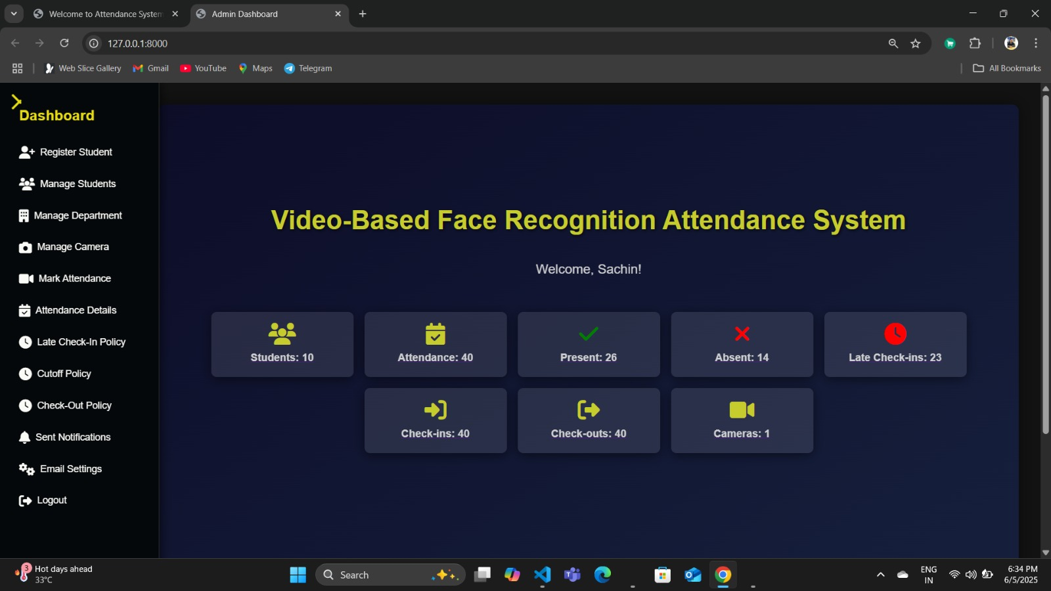

Slide 14
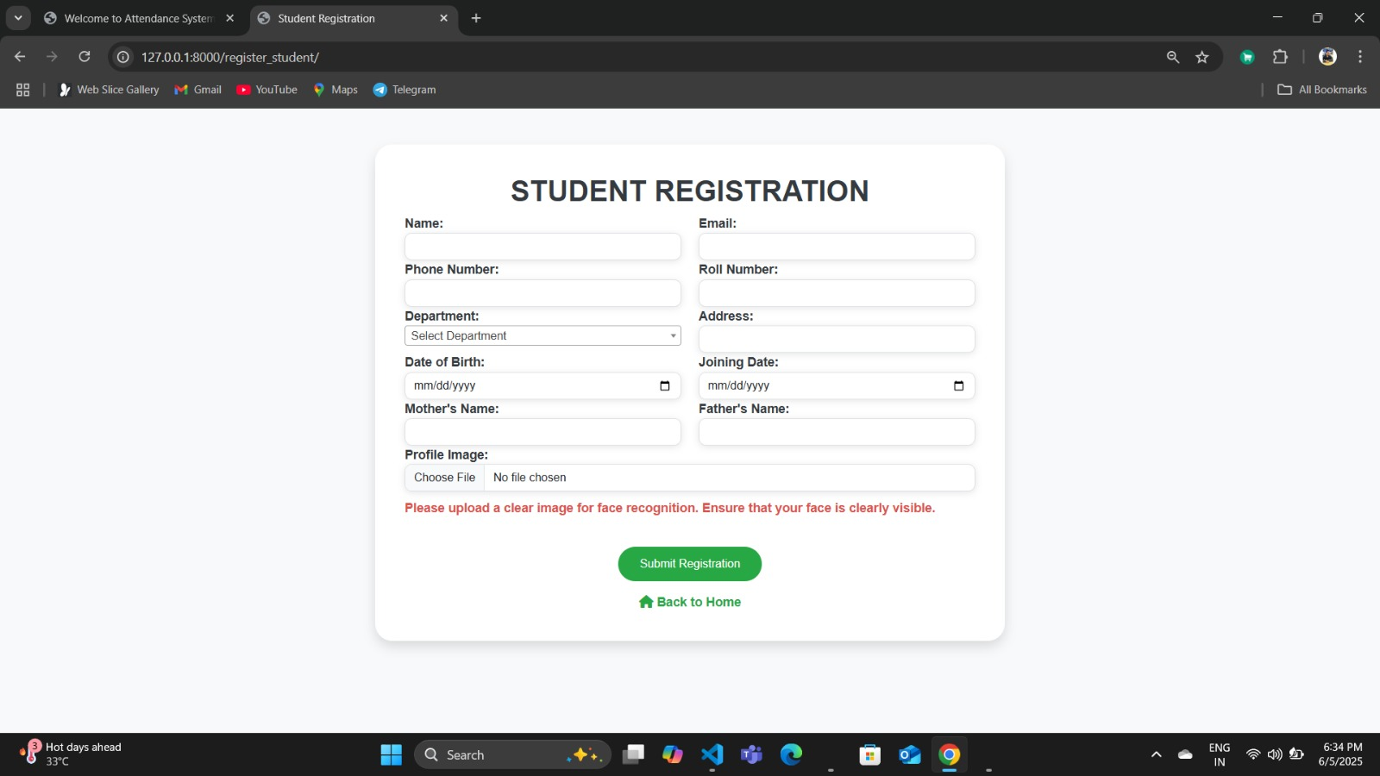

Slide 15
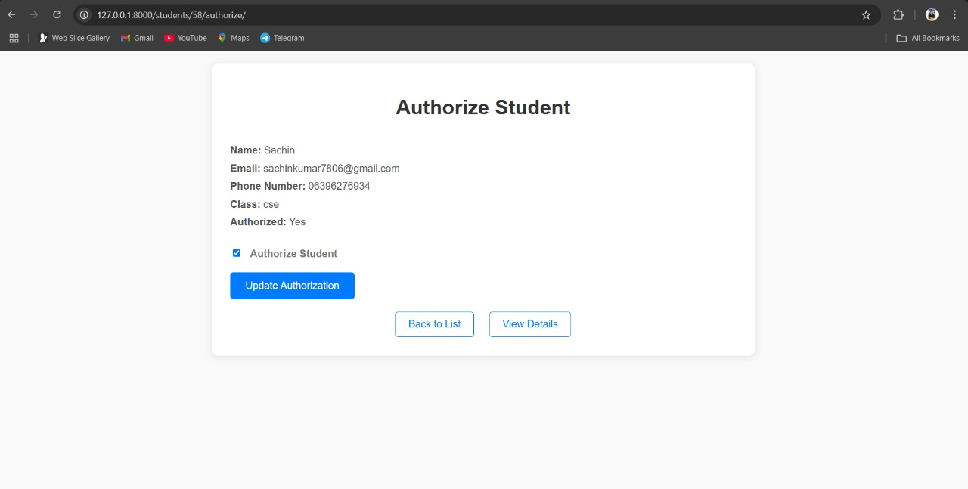

Slide 16
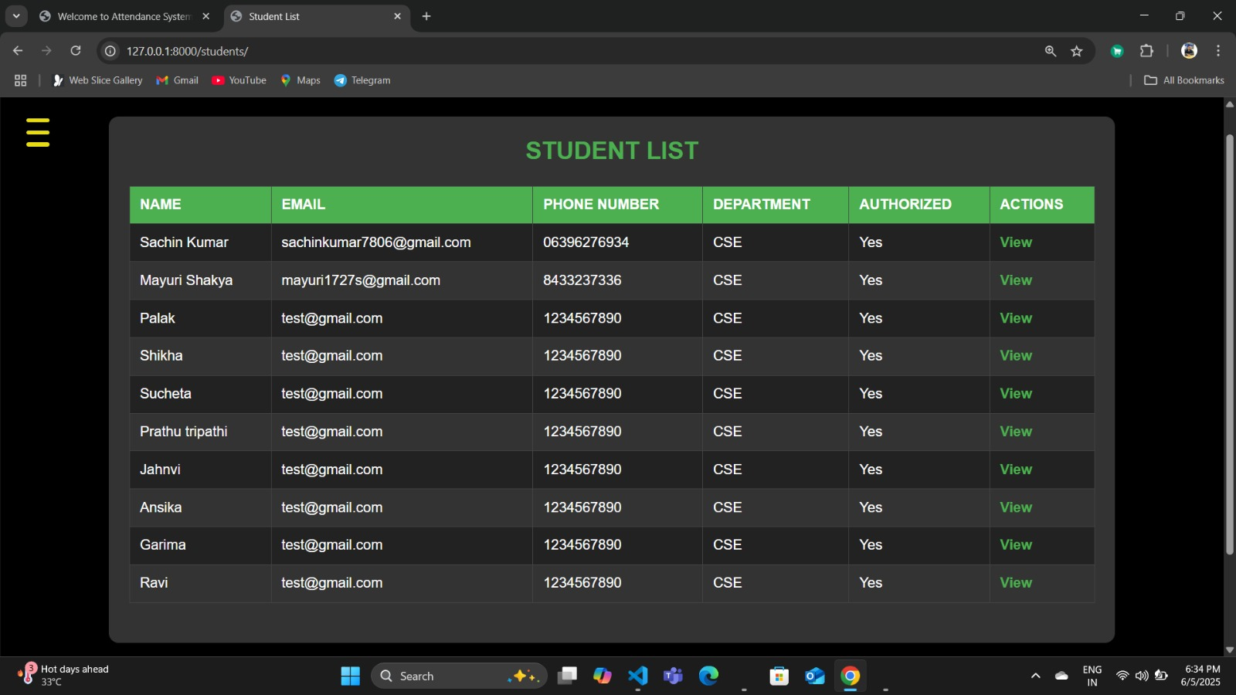

Slide 17
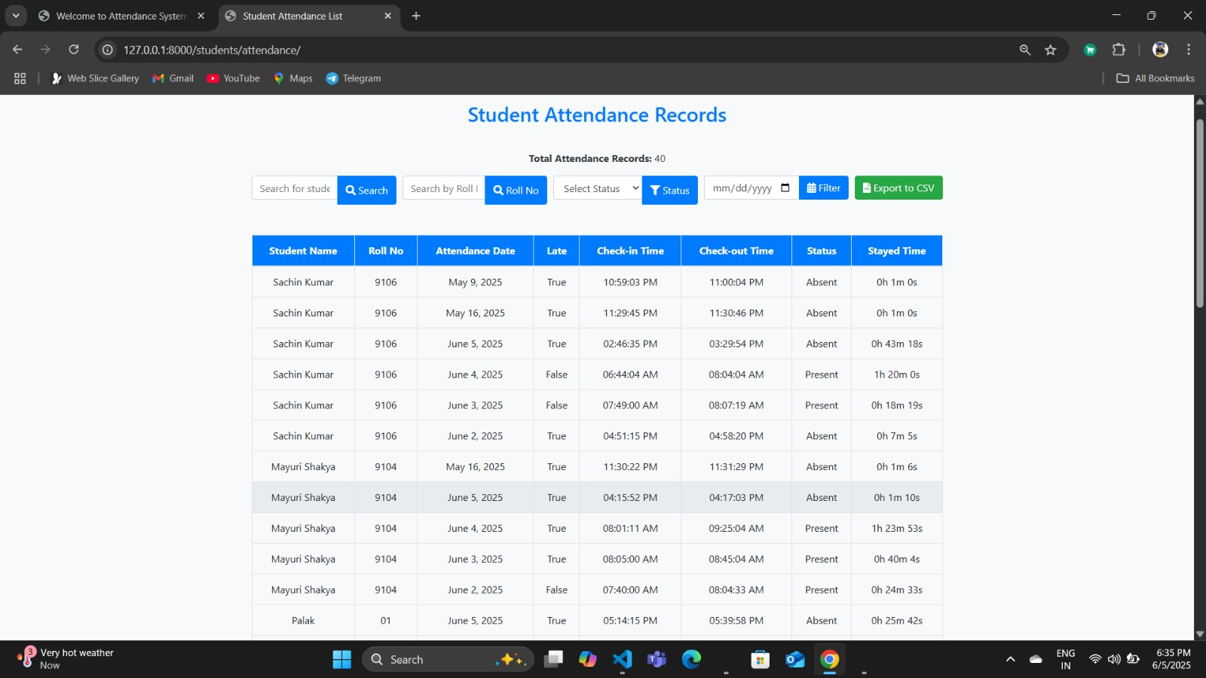

Slide 18
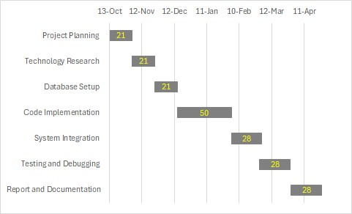

Slide 19
Thank You

